Slide 1
Features Of NoSQL
Instructor: Sriya Ivaturi

Slide 2
Schema-less Structure
Feature:
No fixed table schema — each record can have a different structure.
Example:
In MongoDB, documents in the same collection can look like this:
Benefit:
✅ Easier to adapt when your application requirements change.
{ "name": "Alice", "age": 22 }
{ "name": "Bob", "email": "bob@example.com", "city": "Delhi" }

Slide 3
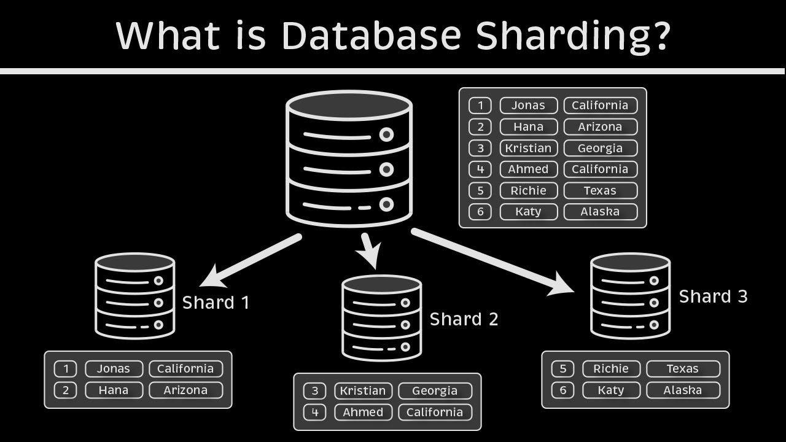

Slide 4
Distributed Architecture
Feature:
  Data is automatically sharded and replicated across multiple servers.
Example:
  Even if one node fails, others continue to serve data.
Benefit:
  ✅ Increases reliability and uptime.

Slide 5
Horizontal Scalability
Feature:
  Instead of upgrading one large server, you can add multiple smaller servers.
Example:
  Cassandra and MongoDB automatically distribute data across multiple servers (nodes).
  Ideal for apps like Instagram or Netflix with millions of users.
Benefit:
  ✅ Handles large user loads without slowing down.

Slide 6
High Performance
Feature:
  Designed for fast read/write operations and real-time responses.
Example:
  Redis stores data in memory → microsecond response times.
Used in leaderboards, session caching, and live chat apps.
Benefit:
  ✅ Great for performance-critical applications.

Slide 7
Variety of Data Models
Model | Example Database | Usage Example
Key-Value | Redis | Session data, caching
Document | MongoDB | User profiles, product data
Column-Family | Cassandra | IoT or time-series data
Graph | Neo4j | Social networks, recommendations
Benefit: ✅ Choose the best model for your data type.

Slide 8
High Availability & Fault Tolerance
Feature:
  Automatic data replication ensures continuous operation even if a node fails.
Example:
  CouchDB and Cassandra replicate data across multiple data centers.
  MongoDB replica sets ensure failover recovery.
Benefit:
  ✅ Prevents downtime and data loss.

Slide 9
Handles Big Data Efficiently
Feature:
  Optimized for huge datasets — both structured and unstructured.
Example:
  Cassandra handles terabytes of sensor or log data.
  MongoDB Atlas scales automatically in the cloud.
Benefit:
  ✅ Perfect for analytics, IoT, and social media data.

